Slide 1

Overview of the COVID-19 Datasets on Harvard Dataverse
Tao Hu, Postdoc Fellow
The Center for Geographic Analysis (CGA)
1/17/2021

Slide 2
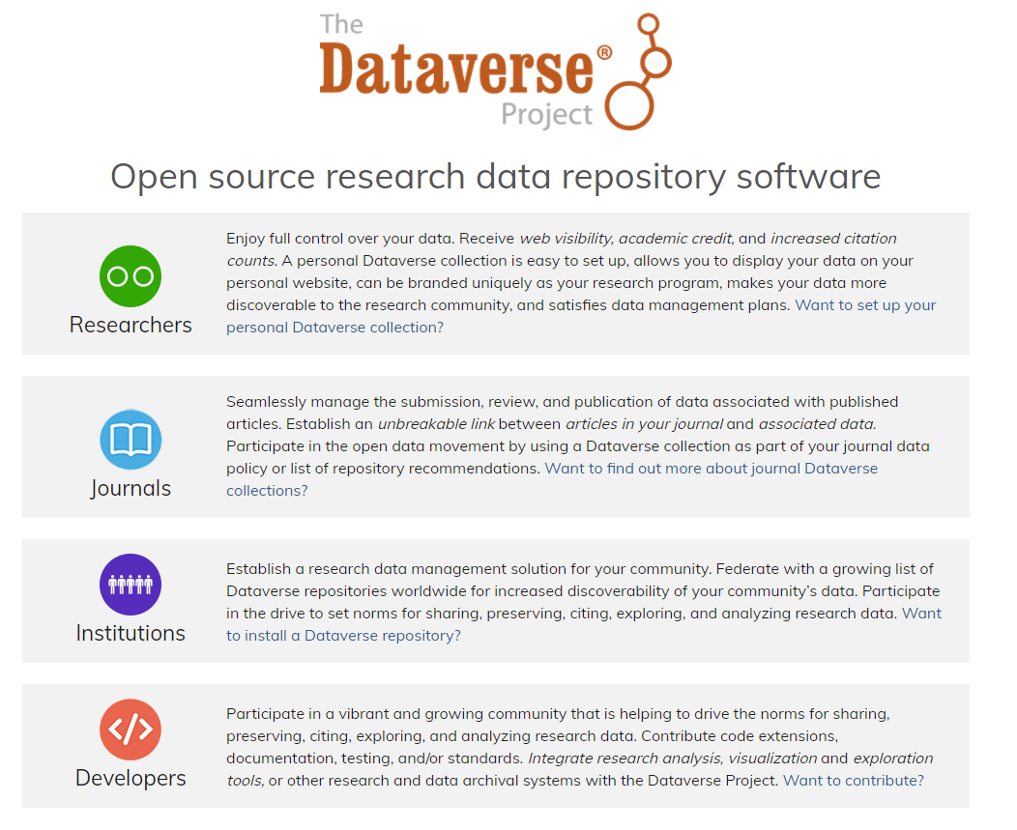
Dataverse Project
Source: https://dataverse.org
Notes:
VPN/Dataverse API….

Slide 3
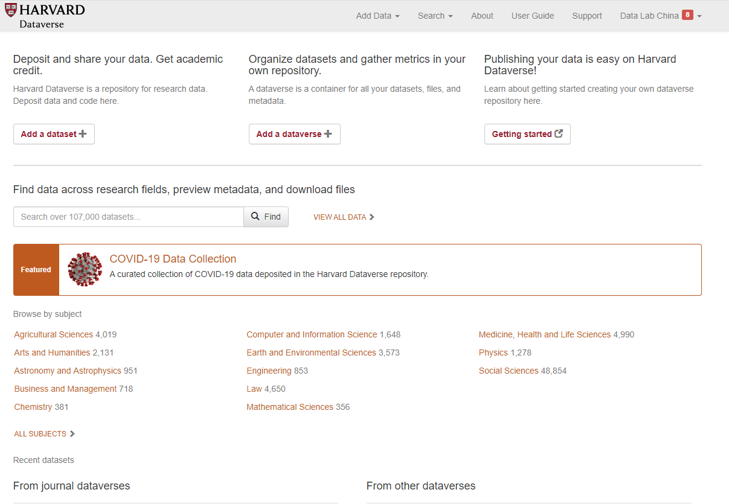
Harvard Dataverse
https://dataverse.harvard.edu

Slide 4
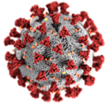
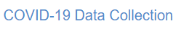
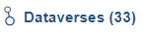
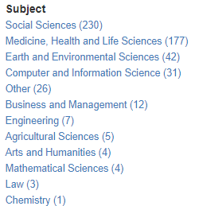
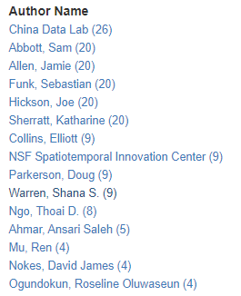
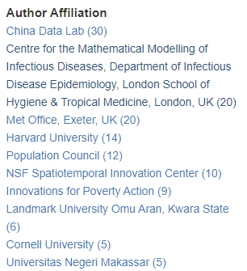
COVID-19 Data Collection
https://dataverse.harvard.edu/dataverse/covid19
Notes:
VPN/Dataverse API….

Slide 5
Background
China Data Lab: NSF Industry-University Cooperative Research Centers (I/UCRC) Program (Harvard)
NSF’s Rapid Response Research (RAPID) Program (Harvard + GMU)
Integrating data from different sources
Standardizing different data units and formats
Matching data with geographic entities for spatial analysis
Publishing data in permanent collections
Supporting collaborative research on COVID-19 studies
Notes:
Data are scattered at many sources
Data are not comparable, lack of standard for interoperability
Data are not permanent, may be available for a short time only

Slide 6

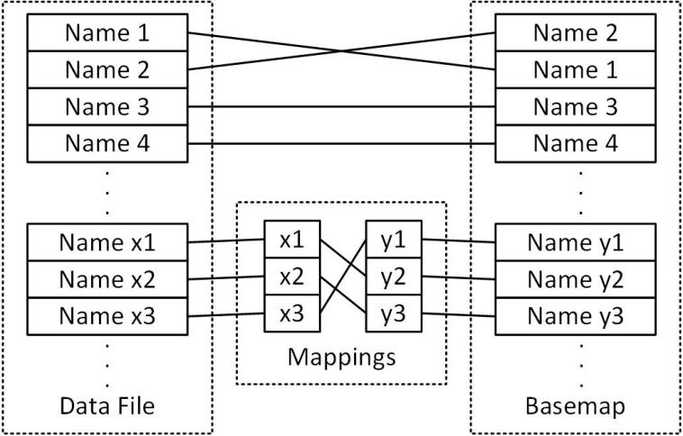
Data Integration with Basemap
Data standardization and association
Data Spatialization
Base map
Social-media
Global News
Research Articles
Climate
Health Facility
COVID-19 Cases
Administrative Regions Mapping
Policy & Regulation
Human Mobility
Social-economics
Notes:
: rich spatial variables for geographic research

Slide 7
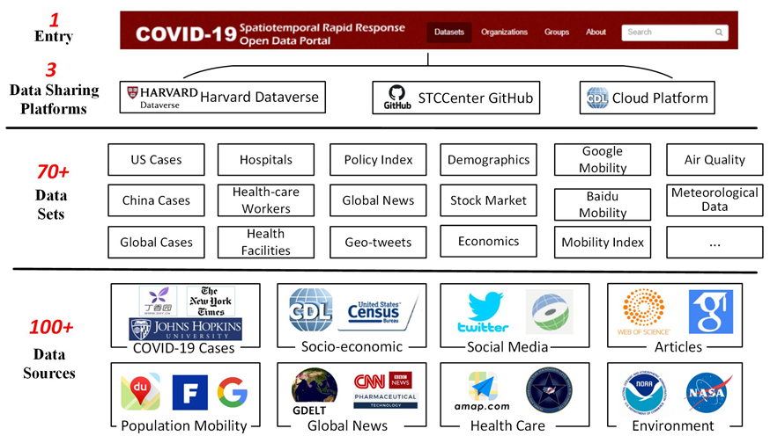
Data Framework

Slide 8
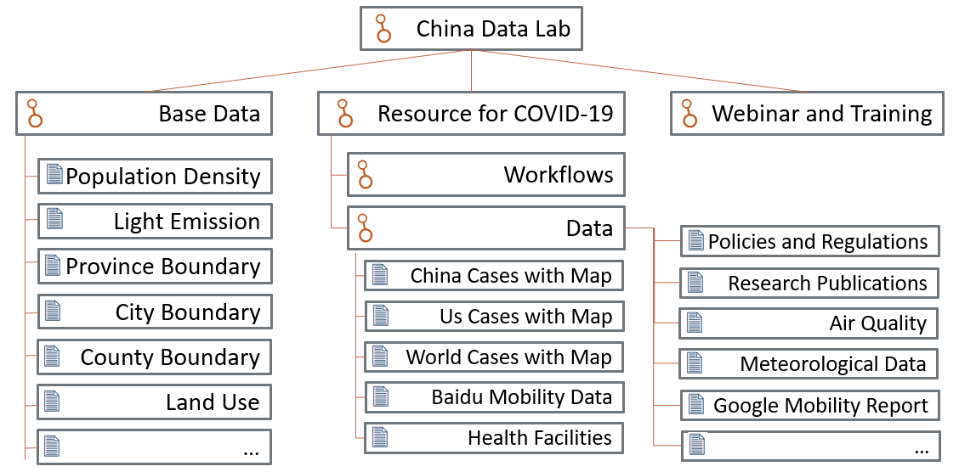
Data Sharing on Harvard Dataverse
Datasets Structures of Dataverse China Data Lab

Slide 9
Data Publishing on Harvard Dataverse
ID | Dataset | Region | DOI | Start Date | Update
1 | World COVID-19 Daily Cases with basemap | Global | https://doi.org/10.7910/DVN/L20LOT | 01/22/2020 | Weekly
2 | US COVID-19 Daily Cases with basemap | US | https://doi.org/10.7910/DVN/HIDLTK | 01/22/2020
3 | China COVID-19 Daily Cases with basemap | China | https://doi.org/10.7910/DVN/MR5IJN | 01/14/2020
4 | Human Mobility Data | China, US | https://doi.org/10.7910/DVN/FAEZIO | 01/01/2020
5 | Health Facilities Data | US, China | https://doi.org/10.7910/DVN/KRSGT3
6 | News and Policy Data | Global | https://doi.org/10.7910/DVN/OAM2JK | 01/01/2020 | Weekly
7 | Scholarly Articles | Global | https://doi.org/10.7910/DVN/MHL8JC | 01/01/2020
8 | Meteorological Data | China | https://doi.org/10.7910/DVN/XETLSS | 12/01/2019
9 | Flight Data | Global | CDL Cloud Platform | 12/01/2019
10 | Social Media Data | Global | CDL Cloud Platform | 01/01/2020
11 | Global News | Global | CDL Cloud Platform | 01/01/2020

Slide 10



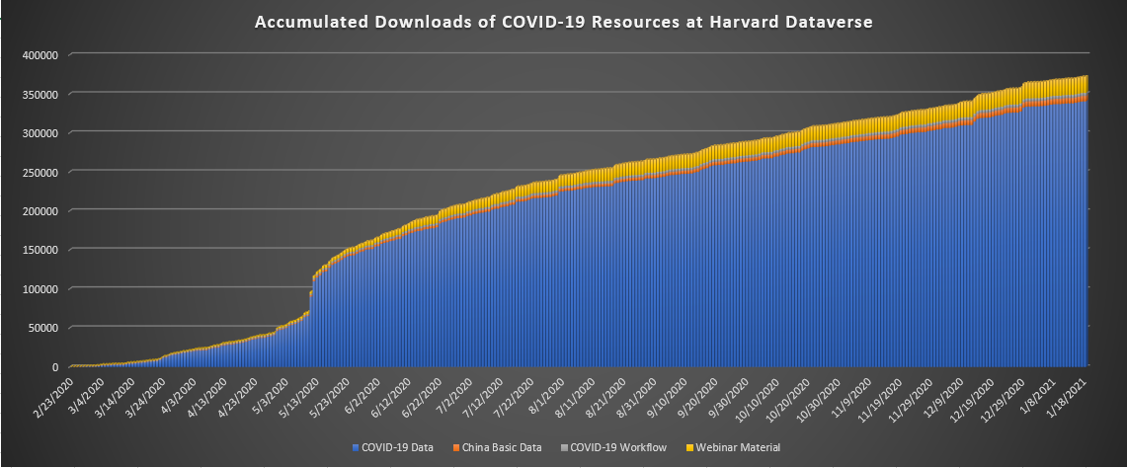
COVID-19 Data Access
Over 370,000 accumulated download times as of January 18, 2021

Slide 11
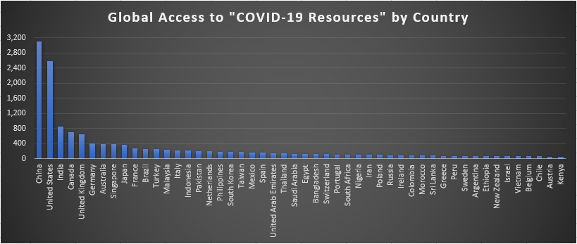
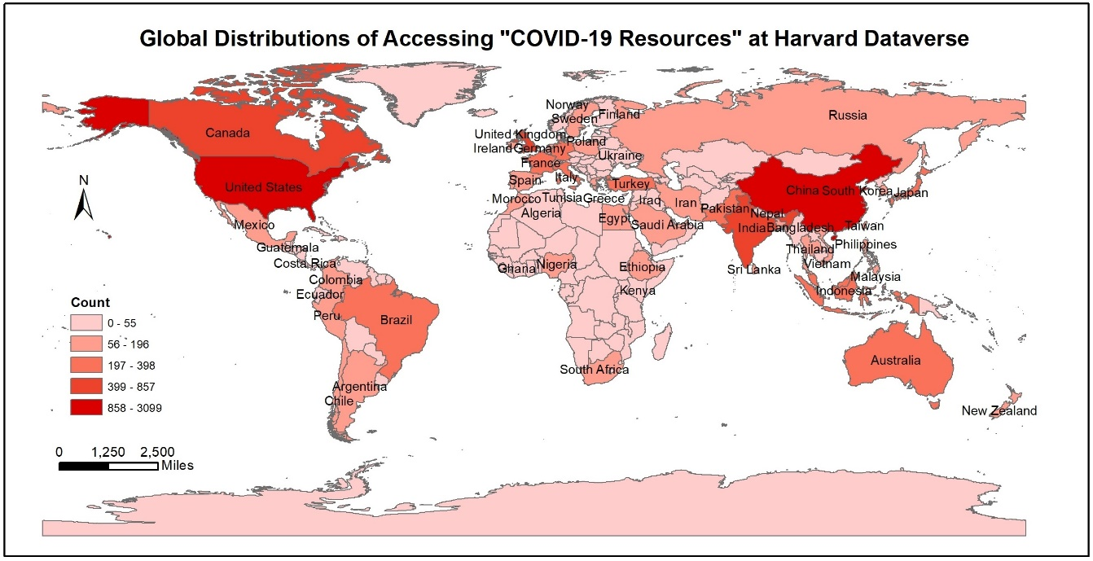
COVID-19 Data Access
Over 150 countries have accessed our COVID-19 data sources as of January 18, 2021

Slide 12
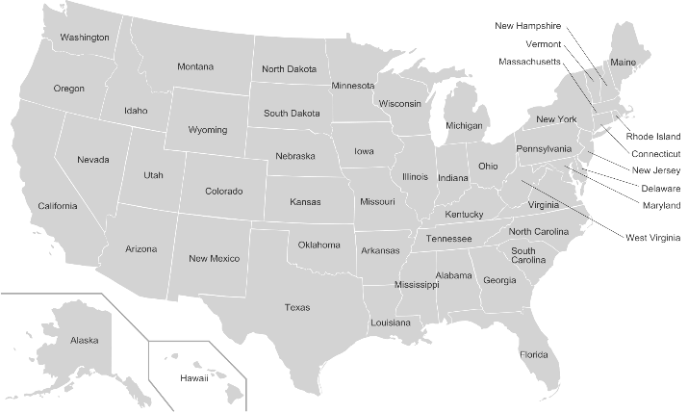
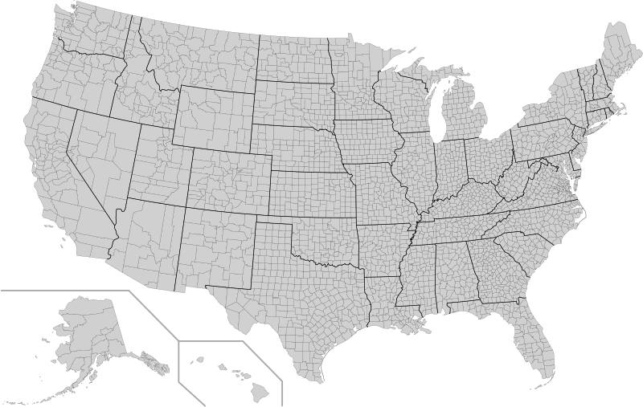
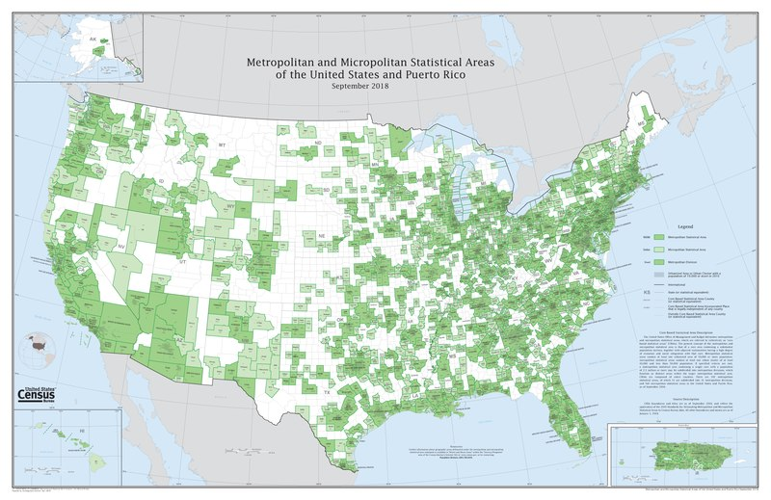
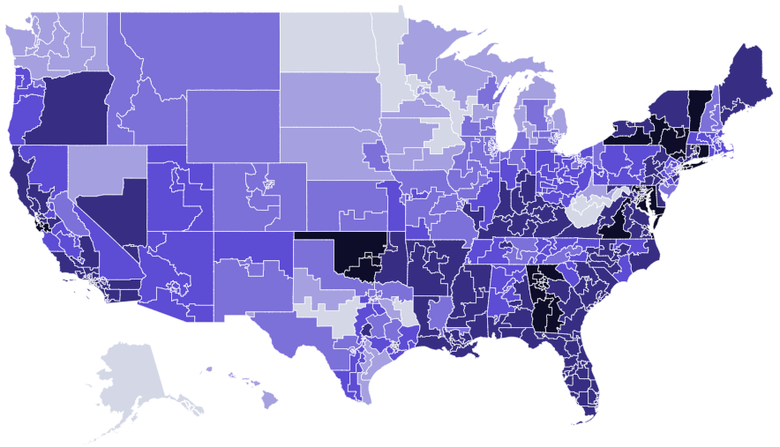
COVID-19 Cases in the US
States
Counties
Source: John Hopkins University
DOI: https://doi.org/10.7910/DVN/HIDLTK
Source: USAFacts
DOI: https://doi.org/10.7910/DVN/HIDLTK
Provided by Subramanian, S.V., School of Public Health
Metropolitan Areas
Congressional Districts
Aggregated from county cases
DOI: https://doi.org/10.7910/DVN/5B8YM8
Census track data + County cases
DOI: https://doi.org/10.7910/DVN/KPI7WW

Slide 13
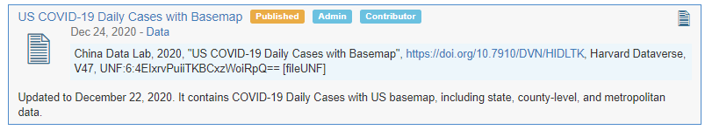
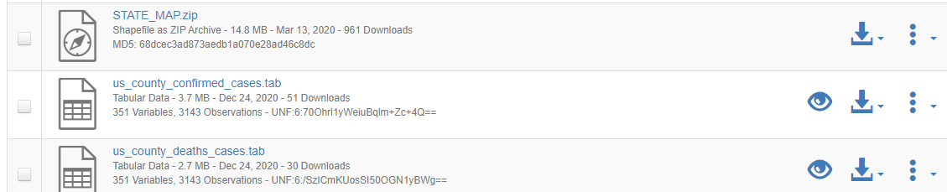
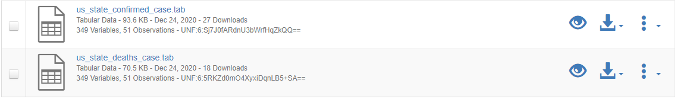
COVID-19 Cases in the US

Slide 14
Human Mobility Datasets
Google Community Mobility Report
Apple Mobility Trends Report
Source：https://www.google.com/covid19/mobility/
Format：tabular/pdf
Admin Level: country, state, and county
DOI: https://doi.org/10.7910/DVN/1CLYWS
Source：https://www.apple.com/covid19/mobility
Format：tabular/pdf
Admin Level: country, state, and city
DOI: https://doi.org/10.7910/DVN/E9EIB6
Foursquare Mobility Reports
Descartes Lab Mobility Data
Source：https://github.com/descarteslabs/DL-COVID-19
Format：tabular/pdf
Admin Level: state, county
DOI: https://doi.org/10.7910/DVN/W2FT3K
Source：https://visitdata.org
Format：tabular
Admin Level: state, and county
DOI: https://doi.org/10.7910/DVN/PFLAH4

Slide 15
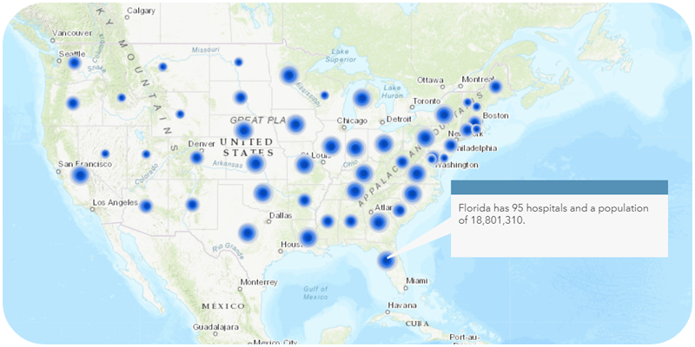
Health Facilities
Provider: China Data Lab
Data Source：Homeland Infrastructure Foundation
Format：table (csv)
DOI: https://doi.org/10.7910/DVN/KRSGT3
Last Update: December 23, 2020
The facilities include hospitals, medical centers, federally qualified health centers, home health services and nursing homes. Hospitals have been categorized into children, chronic disease, critical access, general acute care, long term care, military, psychiatric, rehabilitation, special, and women based on the range of the available values from the various sources after removing similarities.

Slide 16
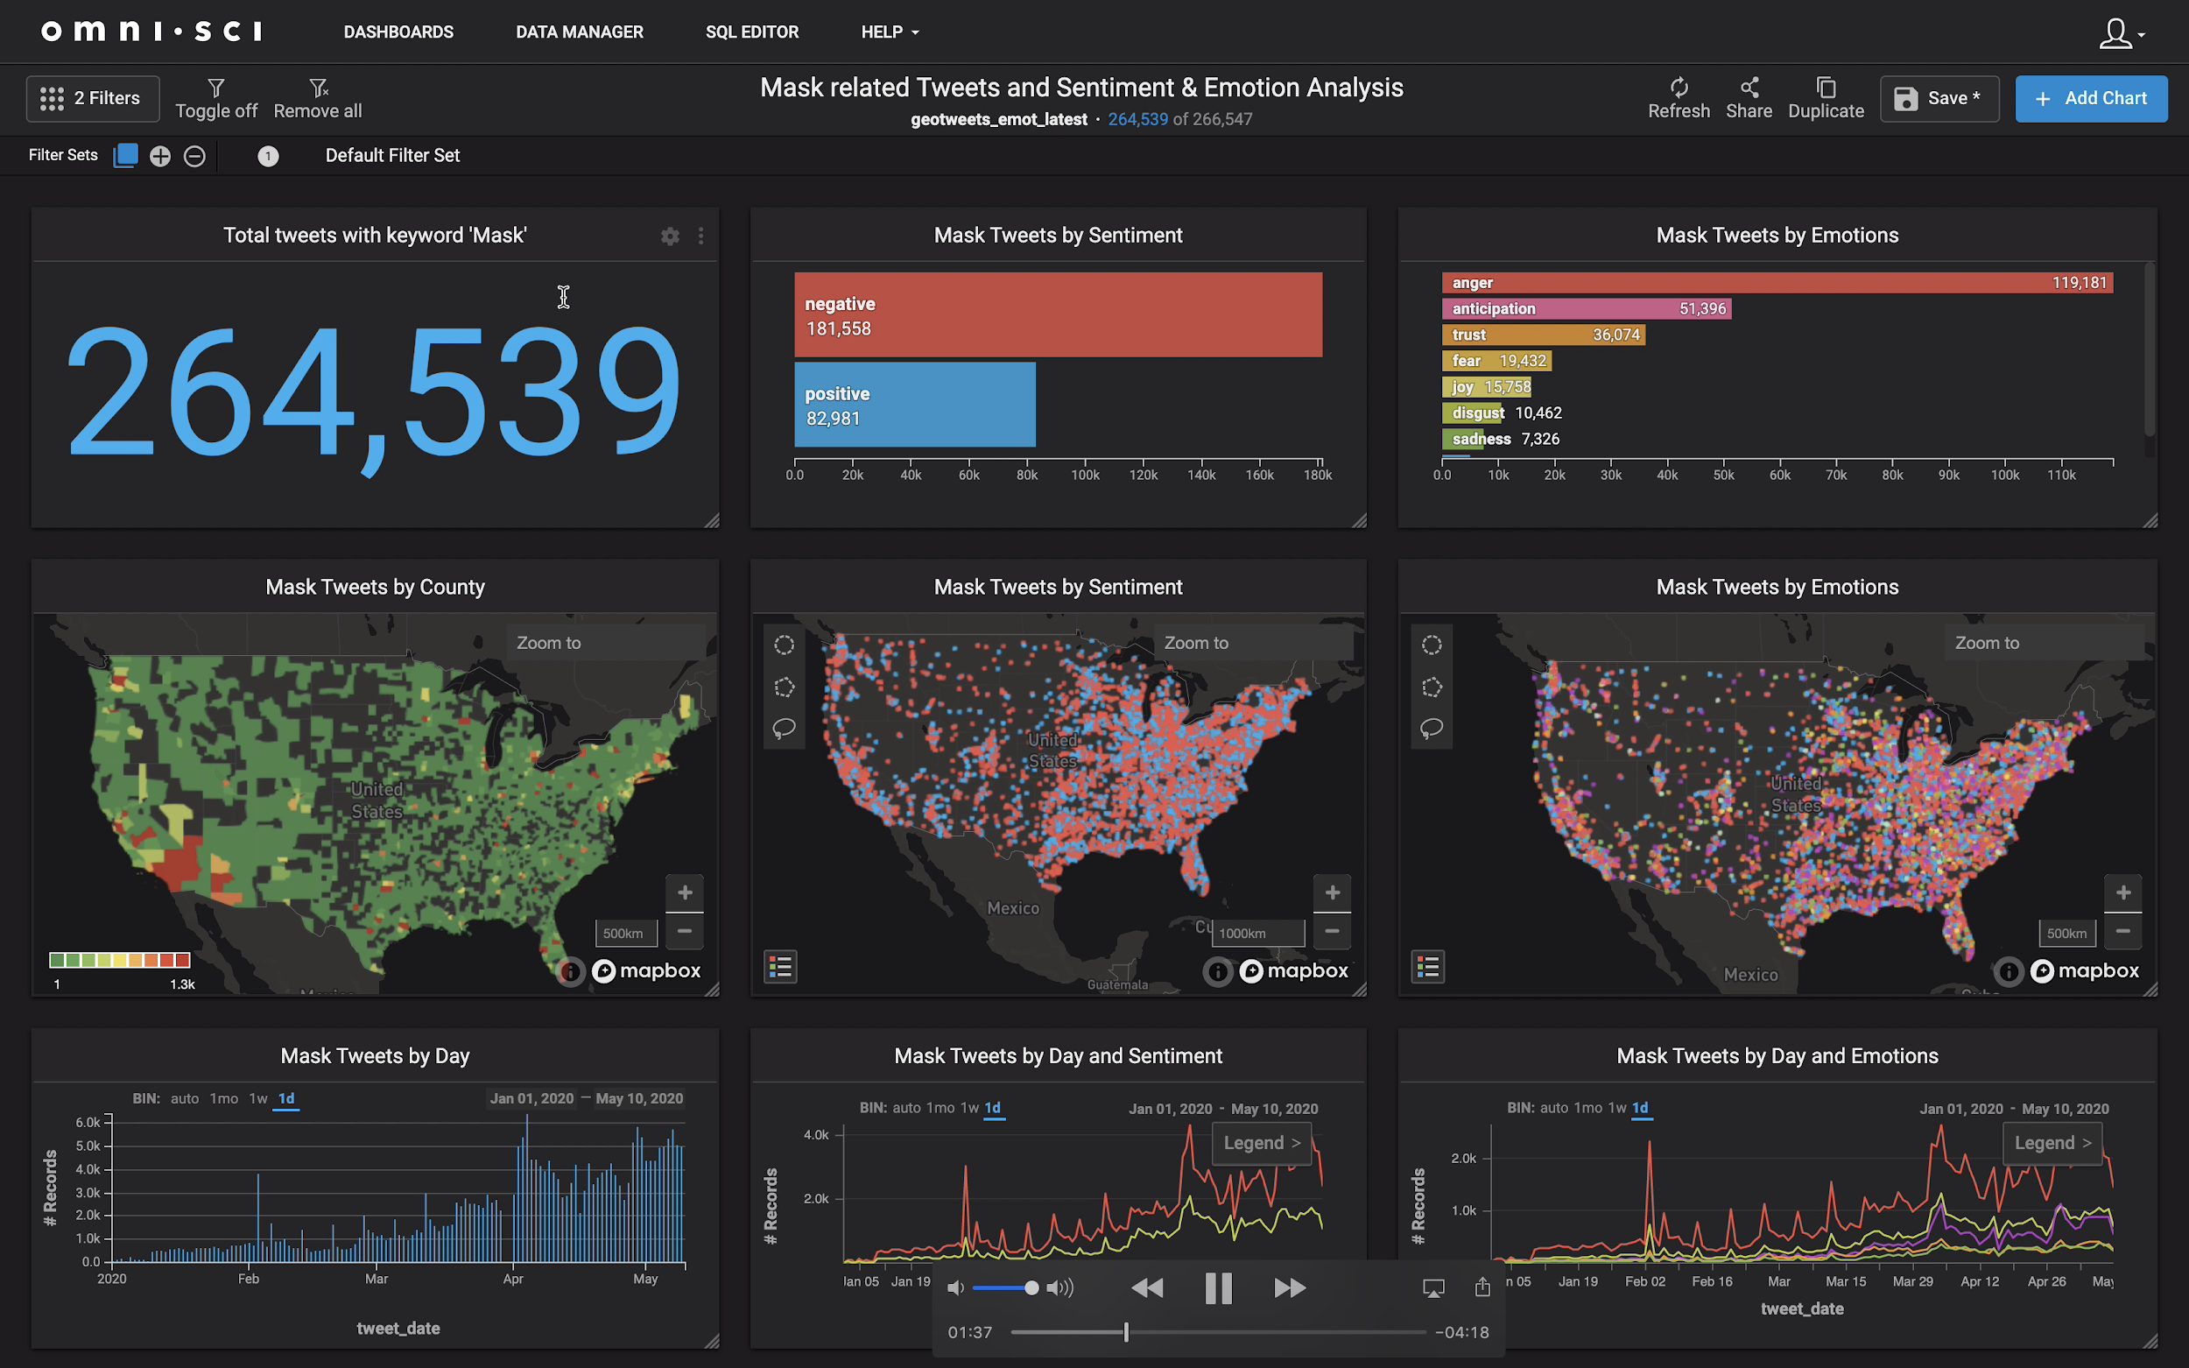
Social Media
Geotweet Archive v2.0: A global social media record with high granularity for geography and time.
Provider: The Center for Geographic Analysis (CGA)
Data Source：Twitter
Format：table (csv)
DOI: https://doi.org/10.7910/DVN/3NCMB6
Extends from 2010 to the present
All records geotagged by GPS or user-designated place
Estimated size 10 billion records
Updated daily
Stored on Harvard FASRC
Geotweets Data Visualization with Omnisci
Notes:
The CGA maintains something we call the Geotweet Archive, a dataset of georeferenced tweets going back to 2010. A characteristic of this dataset, useful for COVID-19 research, is every record has a precise geographic and temporal tag, making it useful when a better understanding of human sentiment as it changes across time and geographic space is needed.
The data is stored on Harvard’s Cannon computation cluster with easy access to scalable processing using a wide range of data science applications including on the GIS side, OmniSci, GeoPandas, and PostGIS.
(if you cut second slide)
Discussions are underway to make the Archive more directly accessible from Dataverse. There will be more on this by Ben Lewis in the geospatial breakout room.

Slide 17

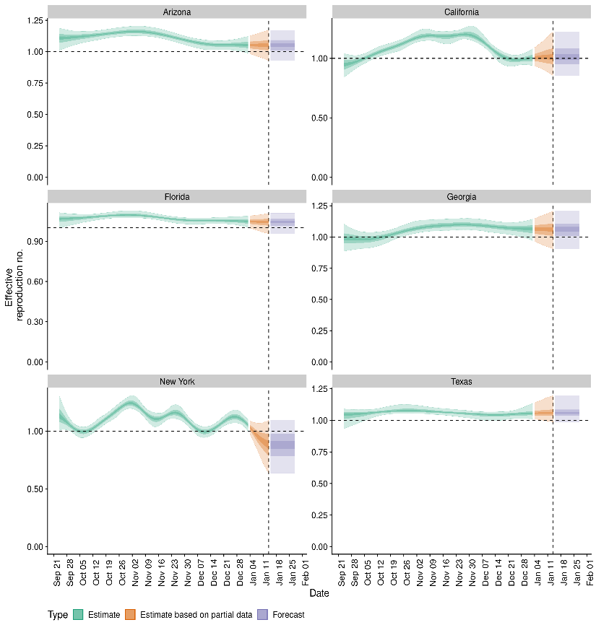
Reproduction Rate
National and Subnational Estimates of the Covid 19 Reproduction Number (R) for the United States of America Based on Test Results
Provider: Centre for Mathematical Modeling of Infections Diseases
Format：table (csv)
DOI: https://doi.org/10.7910/DVN/BZ7FPH
Last Update：Jan 15, 2021
Identifying changes in the reproduction number, rate of spread, and doubling time during the course of the COVID-19 outbreak whilst accounting for potential biases due to delays in case reporting both nationally and subnationally in the United States of America. These results are impacted by changes in testing effort, increases and decreases in testing effort will increase and decrease reproduction number estimates respectively.

Slide 18

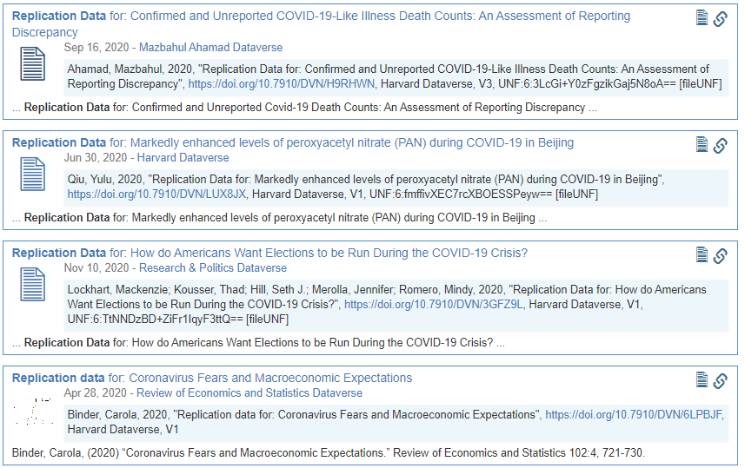
Data for Publication Replication
"Replication Data"
https://dataverse.harvard.edu/dataverse/covid19?q=%22Replication+Data%22&types=datasets

Slide 19
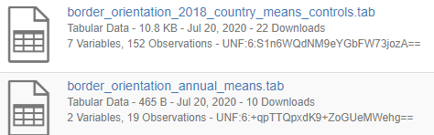

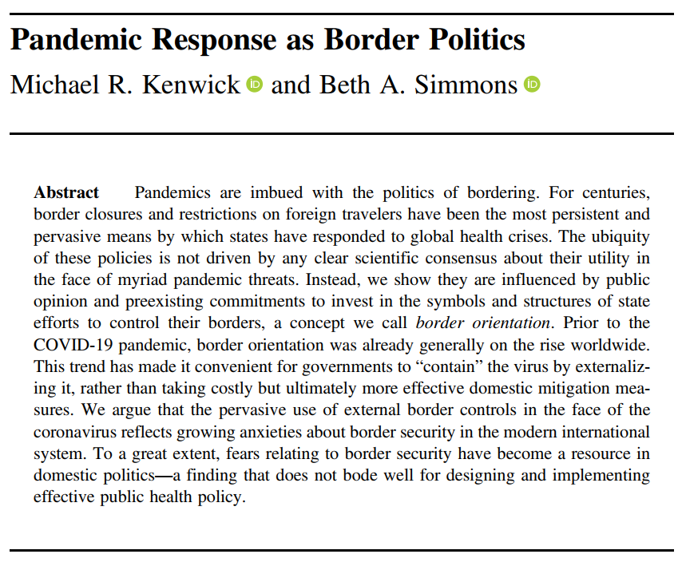

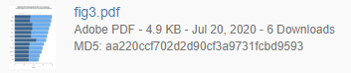
Data for Publication Replication
https://dataverse.harvard.edu/dataverse/covid19?q=%22Replication+Data%22&types=datasets
Publication
Data
Code
Result
Kenwick, Michael; Beth Simmons, 2020, "Replication Data for: Pandemic Response as Border Politics", https://doi.org/10.7910/DVN/J0PGNY, Harvard Dataverse, V1, UNF:6:c9PM5yolQ20XYZCw/GWf5w== [fileUNF]

Slide 20
THANK YOU！
COVID19 Data Collection on Harvard Dataverse
https://dataverse.harvard.edu/dataverse/covid19
Resources for Coronavirus Study
http://chinadatalab.net

